Slide 1

NONSTADIA EVENTS ROAD RACE WALK

Slide 2
TIME TABLE
MACHICO
14 OCTOBER 2025 (THURSDAY)
Time Event Age Gr. R/SF/F
9:00 10K Race Walk M65+ Final
10:50 10K Race Walk M35-60 Final
12:10 10K Race Walk W Final

Slide 3
CALL ROOM
Before the event athletes must report to the Call Room.
Will be checked: BIBS and the national vests.
Time CALL ROOM OPEN CALL ROOM CLOSE
1. 9:00 8:30 8:50
2. 10:50 10:20 10:40
3. 12:10 11:40 12:00
LIMIT TIME 1:45:00

Slide 4
TRANSPORTATION
Avenida do Mar – In front of the Palácio de São Lourenço | MACHICO
07:00 | 07:30
08:50 | 09:20
10:10 | 10:40
A
MACHICO | Avenida do Mar – In front of the Palácio de São Lourenço
13:00 | 13:30
14:50 | 15:20
16:10 | 16:40

Slide 7
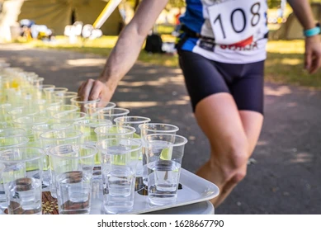
REFRESHMENT
What is allowed?

Slide 8
Scoring
Each category shall be scored separately.
The team results shall be decided by the aggregate of times recorded by the each of the athletes of the team.
In each of the categories, the first three competitors from the some country shall score for the team.
WMA RULE 13.2.2.9 Ties in team scores will be broken by the best time of the first athlete to finish on the tied teams.
If a team fails to finish with a complete scoring team, the runners finishing shall be counted as individuals in the race result and be eligible for the individual awards.
The team with the lowest aggregate of times will be judged the winner.

Slide 9
TEAMS RANKING
In each event a team ranking will be issued by addition of the time of the three best athletes of the team.
There are 2 kinds of teams:
1) Natural Team - 3 athletes from the same country in the same age group; No information from the Team Leader to the TIC is needed before the race.
2) Compose Team - 3 athletes from the same country but from different category. This team competes in the lower age group of one of the athletes.
Compose Team is not allowed if a natural team is possible in one of the concerned age group.

Slide 10
Awards Ceremony
MACHICO 14 OCT
TIME | INDIVIDUAL | TEAMS
13:00 | M65+ | M
 | M65+ | M
 | W | W

Slide 11
GOOD LUCK!

